Slide 1

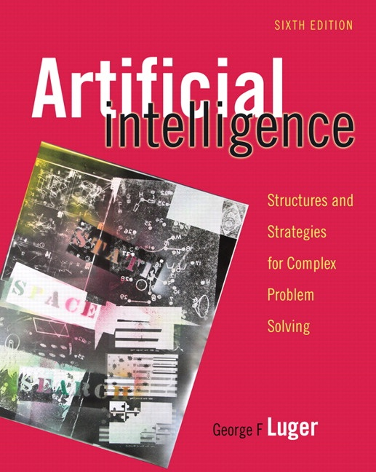
Understanding Natural Language
15.0 Role of Knowledge in Language Understanding
15.1 Deconstructing Language: A Symbolic Analysis
15.2 Syntax
15.3 Syntax and Knowledge with ATN
Parsers
15.4 Stochastic Tools for Language Analysis
15.5 Natural Language Applications
15.6 Epilogue and References
15.7 Exercises
George F Luger
ARTIFICIAL INTELLIGENCE 6th edition
Structures and Strategies for Complex Problem Solving
Luger: Artificial Intelligence, 6th edition. © Pearson Education Limited, 2009
1

Slide 2
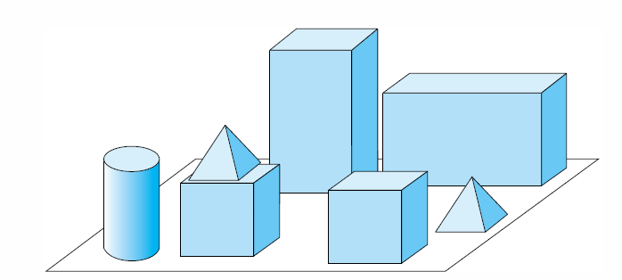
Fig 15.1 A blocks world, adapted from Winograd (1972).
Luger: Artificial Intelligence, 6th edition. © Pearson Education Limited, 2009
2

Slide 3
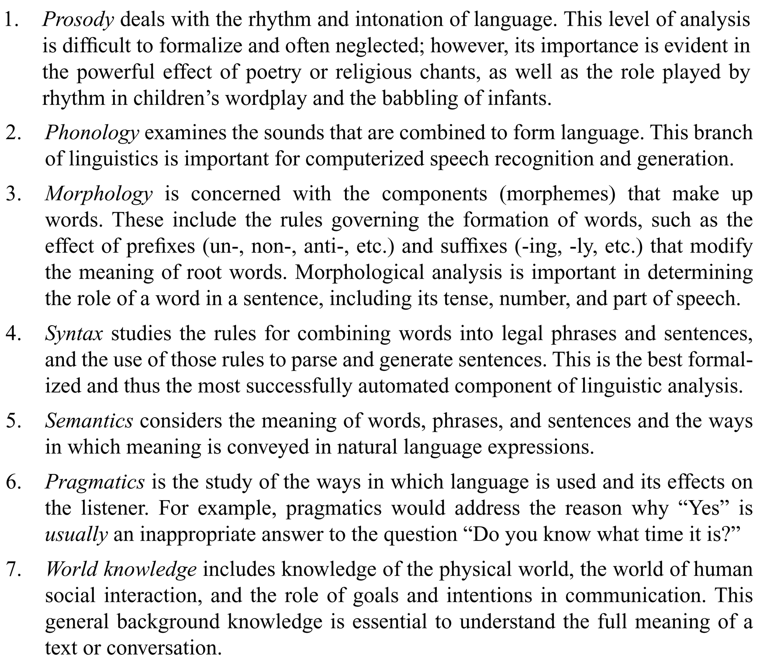
To manage this complexity, linguists have defined different levels of analysis for natural language:
Luger: Artificial Intelligence, 6th edition. © Pearson Education Limited, 2009
3

Slide 4
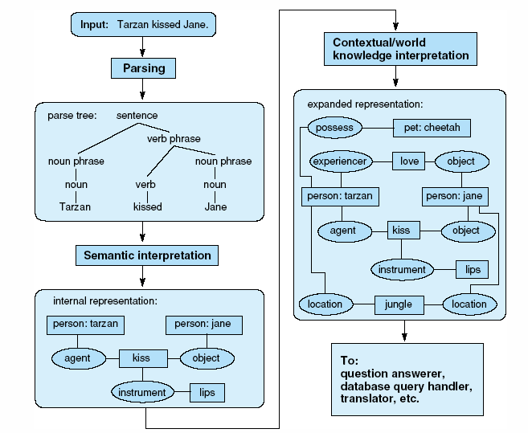
Fig 15.2 Stages in producing an internal representation of a sentence.
Luger: Artificial Intelligence, 6th edition. © Pearson Education Limited, 2009
4

Slide 5
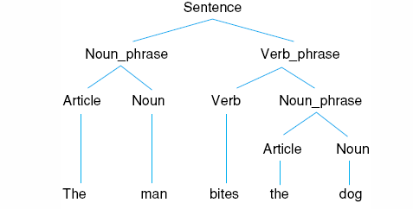
Fig 15.3 Parse tree for the sentence “The man bites the dog.”
Luger: Artificial Intelligence, 6th edition. © Pearson Education Limited, 2009
5

Slide 6
Sentence −−> . Noun Verb predict: Noun followed by a Verb
Noun −−> . mary predict: mary
Noun --> mary . scanned: mary
Sentence --> Noun . Verb completed: Noun; predict: Verb
Verb --> . runs predict: runs
Verb --> runs . scanned: runs
Sentence --> Noun Verb . completed: Verb,
completed: sentence
Luger: Artificial Intelligence, 6th edition. © Pearson Education Limited, 2009 6

Slide 7
Luger: Artificial Intelligence, 6th edition. © Pearson Education Limited, 2009 7

Slide 8
The chart for mary runs, with three state lists, is:
S0: [($ --> . S), start
(S --> . Noun Verb)] predictor
S1: [(Noun --> mary .), scanner
(S --> Noun . Verb)] completer
S2: [(Verb --> runs .)] scanner
(S --> Noun Verb .), completer
($ --> S .)] completer
Luger: Artificial Intelligence, 6th edition. © Pearson Education Limited, 2009 8

Slide 9
function EARLEY-PARSE(words, grammar) returns chart
begin
chart := empty
ADDTOCHART(($ Æ . S, [0, 0]), chart[0]) % dummy start state
for i from 0 to LENGTH(words) do
for each state in chart[i] do
if rule_rhs(state) = … . A … and A is not a part of speech
then PREDICTOR(state)
else if rule_rhs(state) = … . L … % L is part of speech
then SCANNER(state)
else COMLETER(state) % rule_rhs = RHS
end
Luger: Artificial Intelligence, 6th edition. © Pearson Education Limited, 2009 9

Slide 10
procedure PREDICTOR((A Æ … . B …, [i, j]))
begin
for each (B Æ RHS) in grammar do
ADDTOCHART((B Æ . RHS, [j, j]), chart[j])
end
procedure SCANNER((A Æ … . L …, [i, j]))
begin
if (L Æ word[j]) is_in grammar
then ADDTOCHART((L Æ word[j] ., [j, j + 1]), chart[j + 1])
end
procedure COMPLETER((B Æ … ., [j, k]))
begin
for each (A Æ … . B …, [i, j]) in chart[j] do
ADDTOCHART((A Æ … B . …, [i, k]), chart[k])
end
procedure ADDTOCHART(state, state-list)
begin
if state is not in state-list
then ADDTOEND(state, state-list)
end
Luger: Artificial Intelligence, 6th edition. © Pearson Education Limited, 2009 10

Slide 11
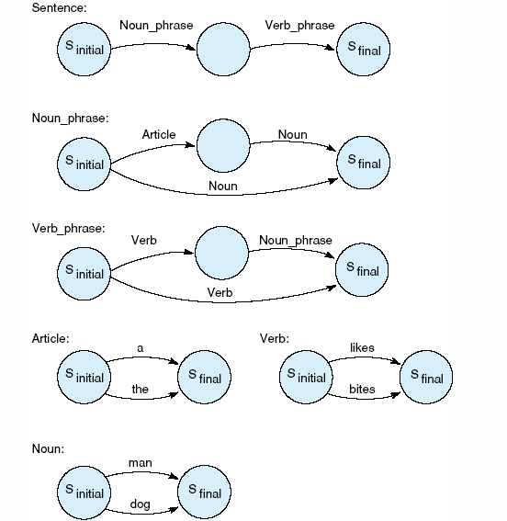
Fig 15.5 Transition network definition of a simple English grammar.
Luger: Artificial Intelligence, 6th edition. © Pearson Education Limited, 2009
11

Slide 12
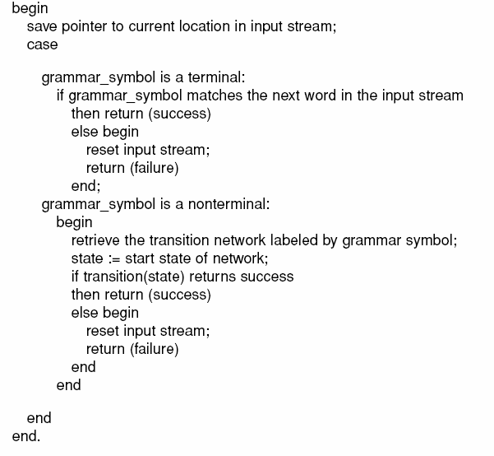
Pseudo-code for a transition network parser appears on the following two slides. It is defined using two mutually recursive functions, parse and transition.
continued…
Luger: Artificial Intelligence, 6th edition. © Pearson Education Limited, 2009
12

Slide 13
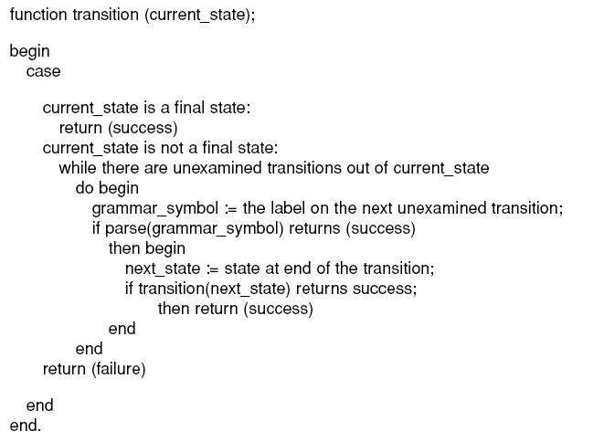
continued from previous slide
Luger: Artificial Intelligence, 6th edition. © Pearson Education Limited, 2009
13

Slide 14
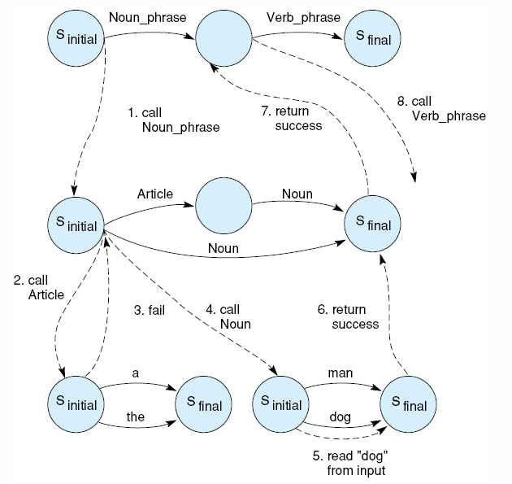
Fig 15.6 Trace of a transition network parse of the sentence “Dog bites.”
Luger: Artificial Intelligence, 6th edition. © Pearson Education Limited, 2009
14

Slide 15
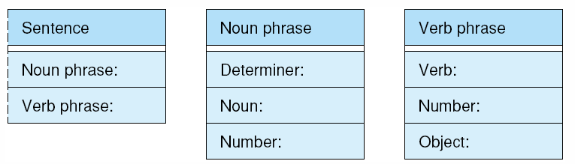
Fig 15.7 Structures representing the sentence, noun phrase, and verb phrase nonterminals of the grammar.
Luger: Artificial Intelligence, 6th edition. © Pearson Education Limited, 2009
15

Slide 16
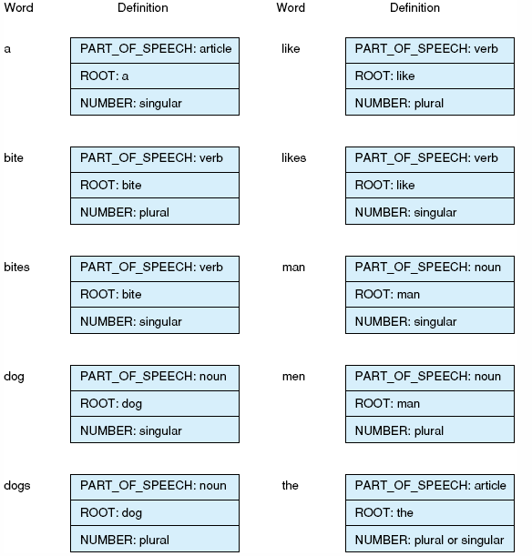
Fig 15.8 Dictionary entries for a simple ATN
Luger: Artificial Intelligence, 6th edition. © Pearson Education Limited, 2009
16

Slide 17
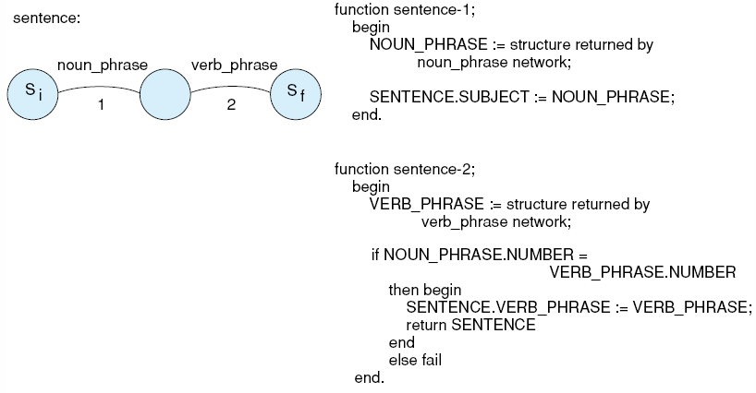
Fig 15.9 An ATN grammar that checks number agreement and builds a parse tree.
continued…
Luger: Artificial Intelligence, 6th edition. © Pearson Education Limited, 2009
17

Slide 18
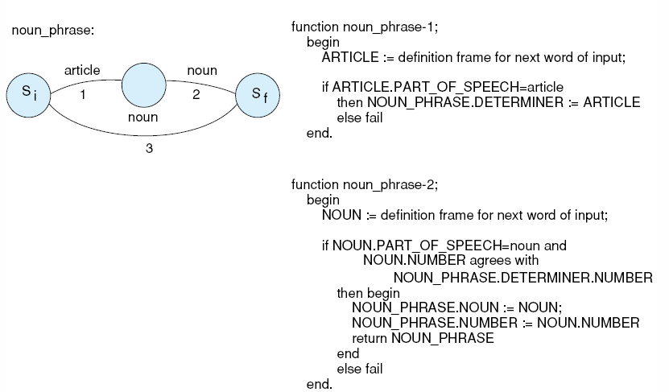
Fig 15.9 continued from previous slide.
continued…
Luger: Artificial Intelligence, 6th edition. © Pearson Education Limited, 2009
18

Slide 19
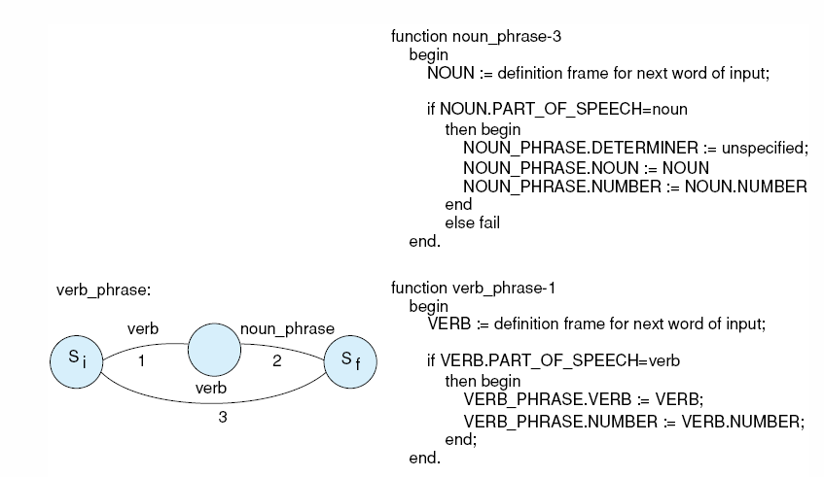
Fig 15.9 continued from previous slide.
continued…
Luger: Artificial Intelligence, 6th edition. © Pearson Education Limited, 2009
19

Slide 20
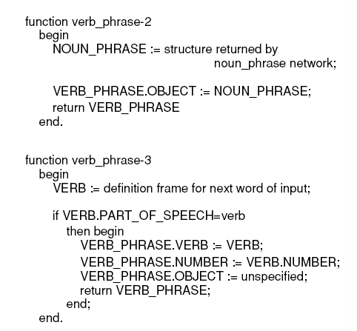
Fig 15.8 continued from previous slide.
Luger: Artificial Intelligence, 6th edition. © Pearson Education Limited, 2009
20

Slide 21
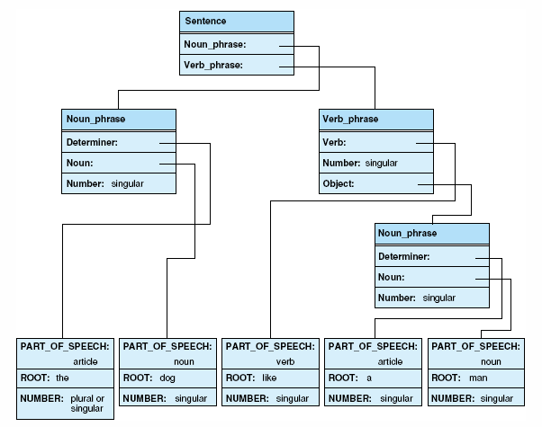
Fig 10 Parse tree for the sentence “The dog likes a man” returned by an ATN parser.
Luger: Artificial Intelligence, 6th edition. © Pearson Education Limited, 2009
21

Slide 22
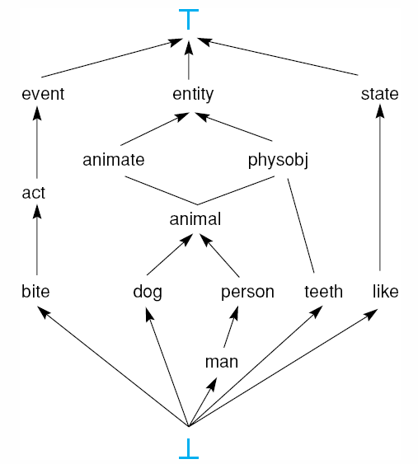
Fig 15.11 Type hierarchy used in “dogs world” example.
Luger: Artificial Intelligence, 6th edition. © Pearson Education Limited, 2009
22

Slide 23
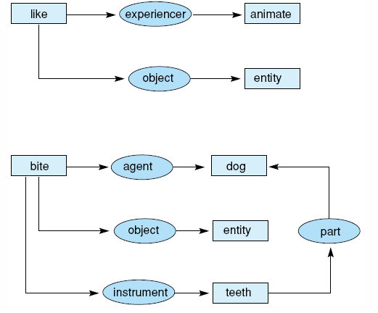
Fig 15.12 Case frames for the verbs “like” and “bite.”
Luger: Artificial Intelligence, 6th edition. © Pearson Education Limited, 2009
23

Slide 24
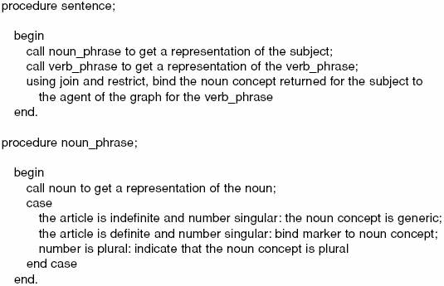
Rules for our example are described as pseudo-code procedures. In each procedure, if a specified join or other test fails, that interpretation is rejected as semantically incorrect.
continued…
Luger: Artificial Intelligence, 6th edition. © Pearson Education Limited, 2009
24

Slide 25
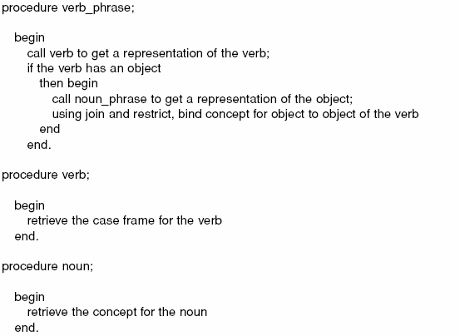
continued from previous slide.
Luger: Artificial Intelligence, 6th edition. © Pearson Education Limited, 2009
25

Slide 26
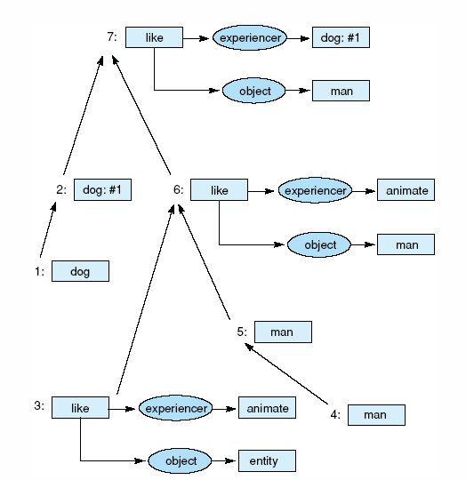
Fig 15.13 Construction of a semantic representation from the parse tree of Figure 15.10.
Luger: Artificial Intelligence, 6th edition. © Pearson Education Limited, 2009
26

Slide 27
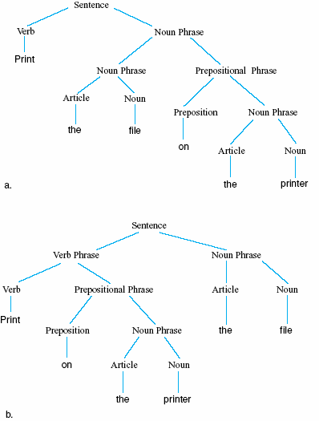
Fig 15.14 Two different parses of “Print the file on the printer.”
Luger: Artificial Intelligence, 6th edition. © Pearson Education Limited, 2009
27

Slide 28
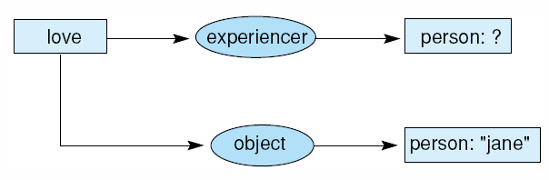
Fig 15.15 Conceptual graph for the question “Who loves Jane?”
Luger: Artificial Intelligence, 6th edition. © Pearson Education Limited, 2009
28

Slide 29
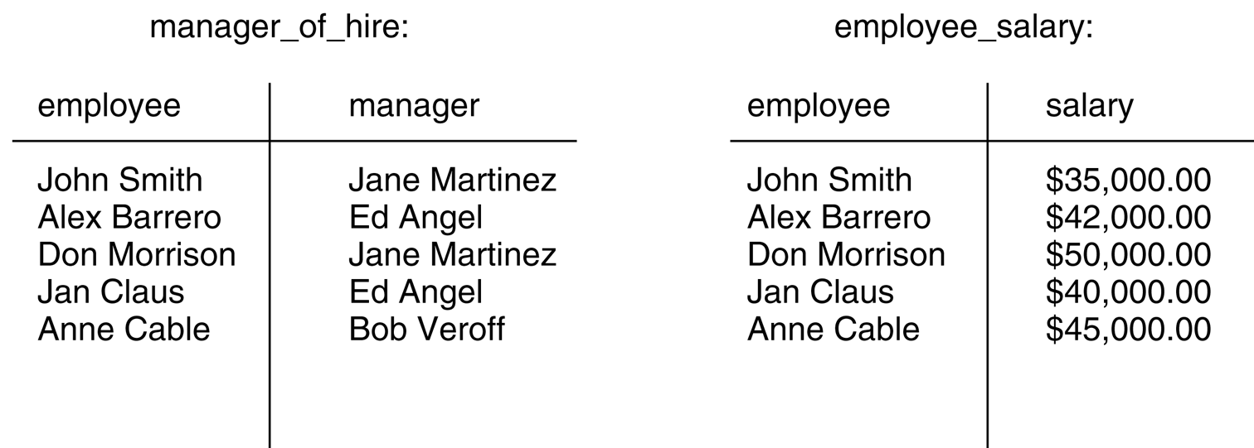
Fig 15.16 Two relations in an employee database.
Luger: Artificial Intelligence, 6th edition. © Pearson Education Limited, 2009
29

Slide 30
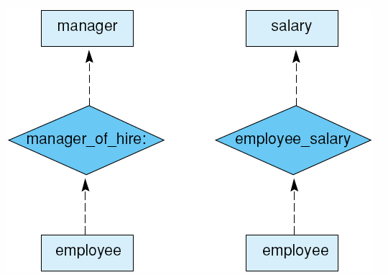
Fig 15.17 Entity-relationship diagrams of the manager_of_hire and employee_salary relations.
Luger: Artificial Intelligence, 6th edition. © Pearson Education Limited, 2009
30

Slide 31
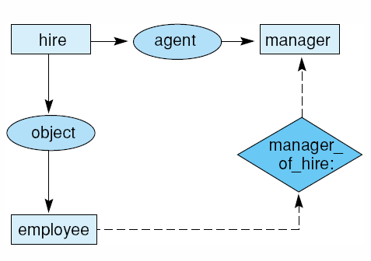
Fig 15.18 Knowledge base entry for “hire” queries.
Luger: Artificial Intelligence, 6th edition. © Pearson Education Limited, 2009
31

Slide 32
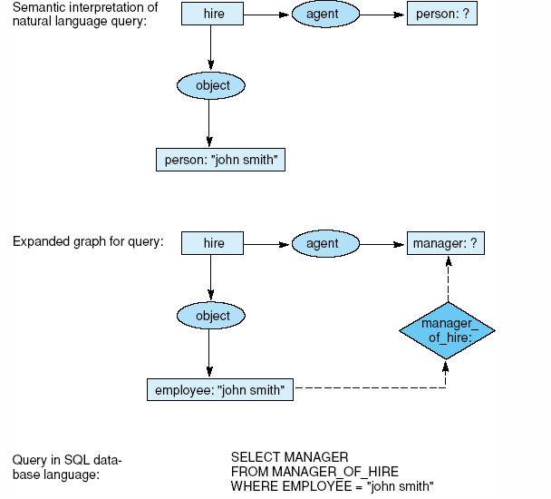
Fig 15.19 Development of a database query from the graph of a natural language input..
Luger: Artificial Intelligence, 6th edition. © Pearson Education Limited, 2009
32

Slide 33
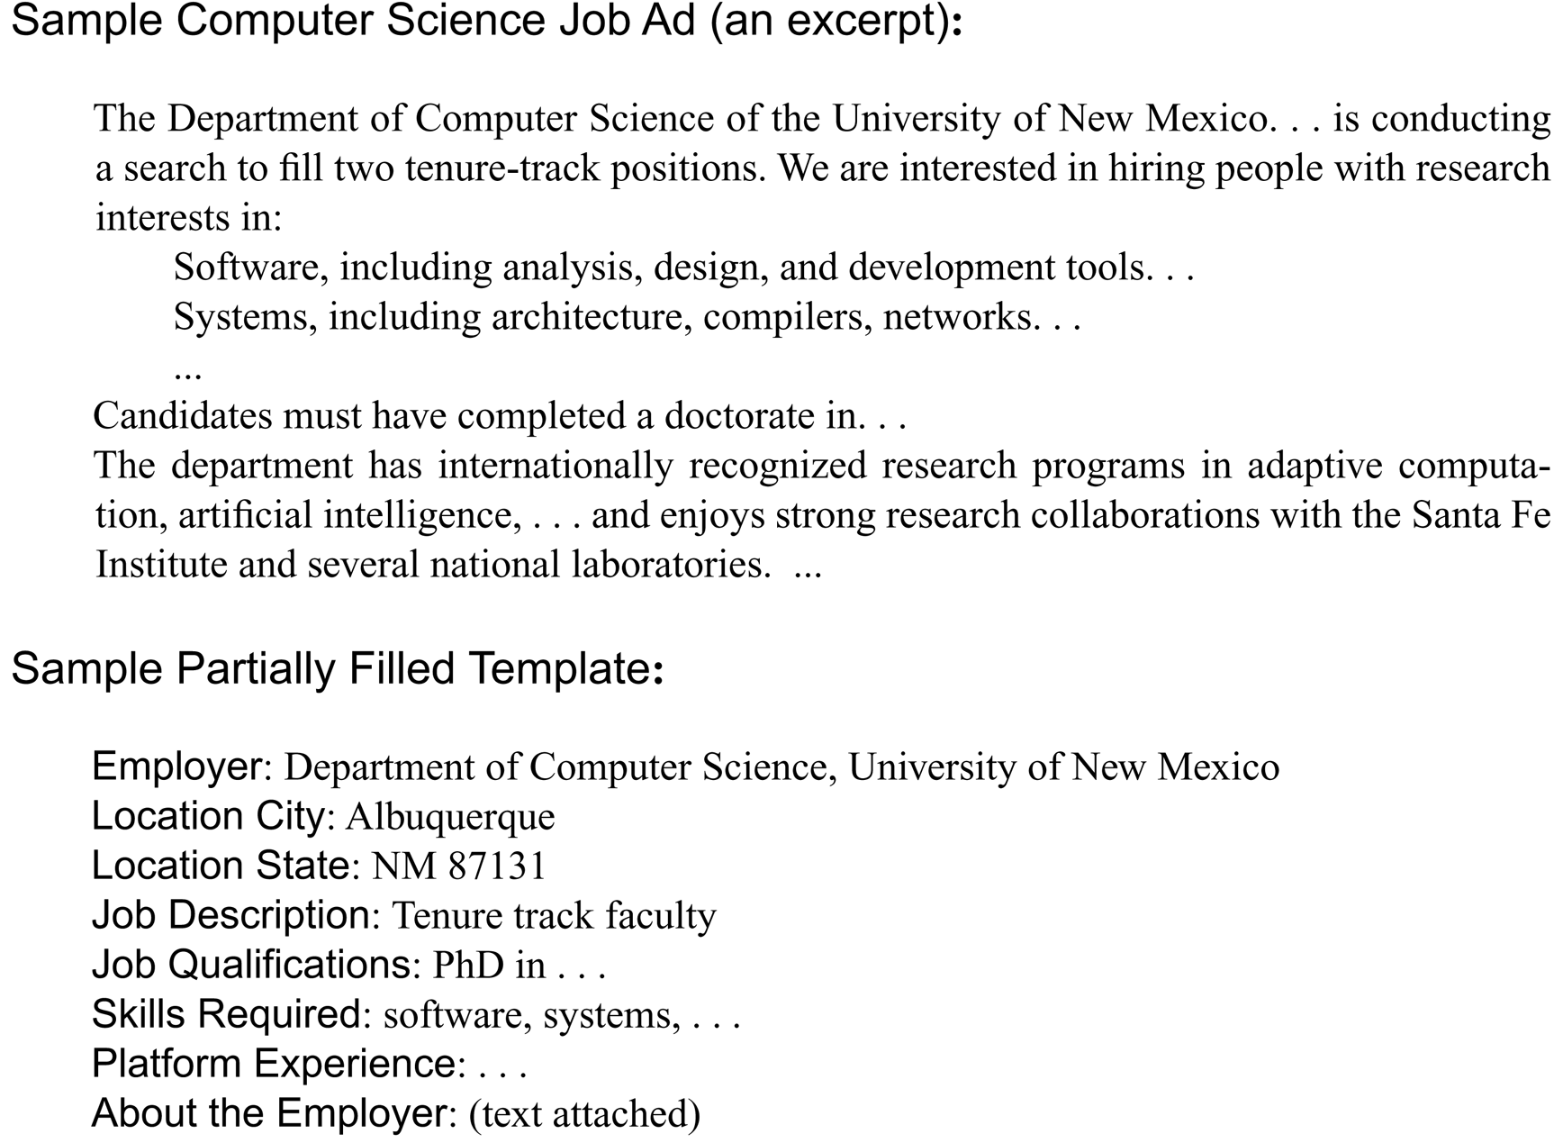
Fig 15.20 Sample text, template summary, and information extraction for computer science advertisement.
Luger: Artificial Intelligence, 6th edition. © Pearson Education Limited, 2009
33

Slide 34
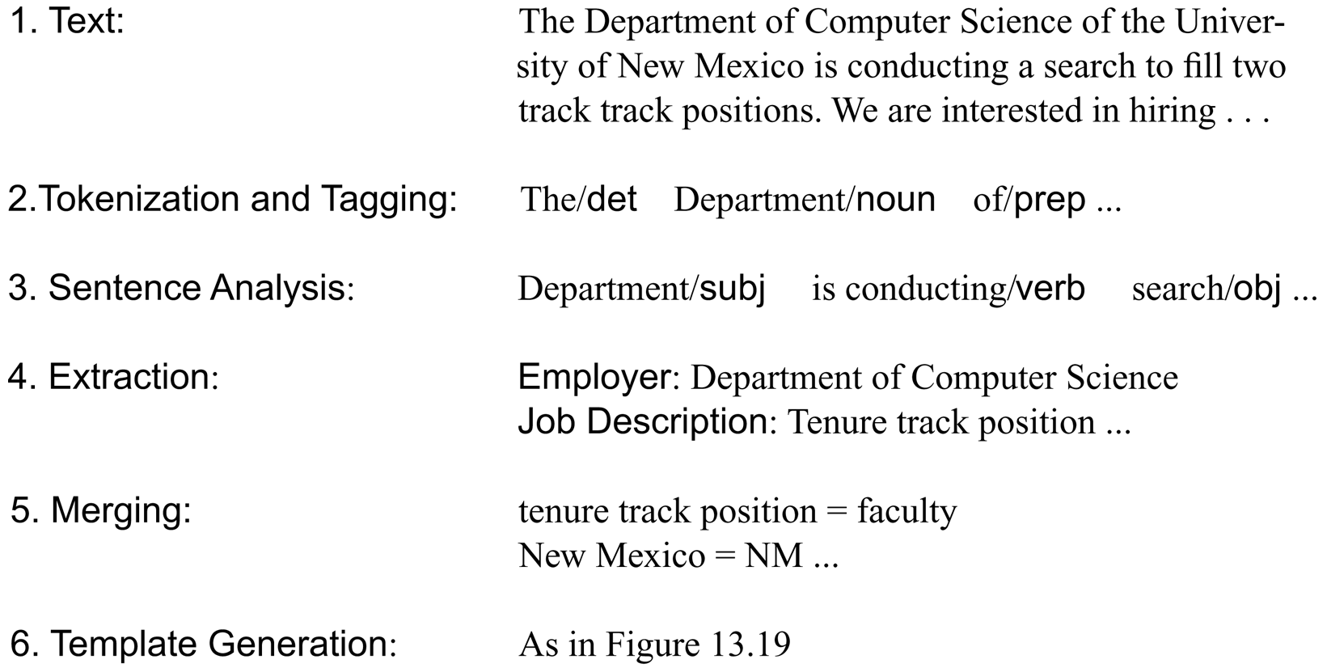
Fig 15.21 An architecture for information extraction, from Cardie (1997).
Luger: Artificial Intelligence, 6th edition. © Pearson Education Limited, 2009
34

